Slide 1
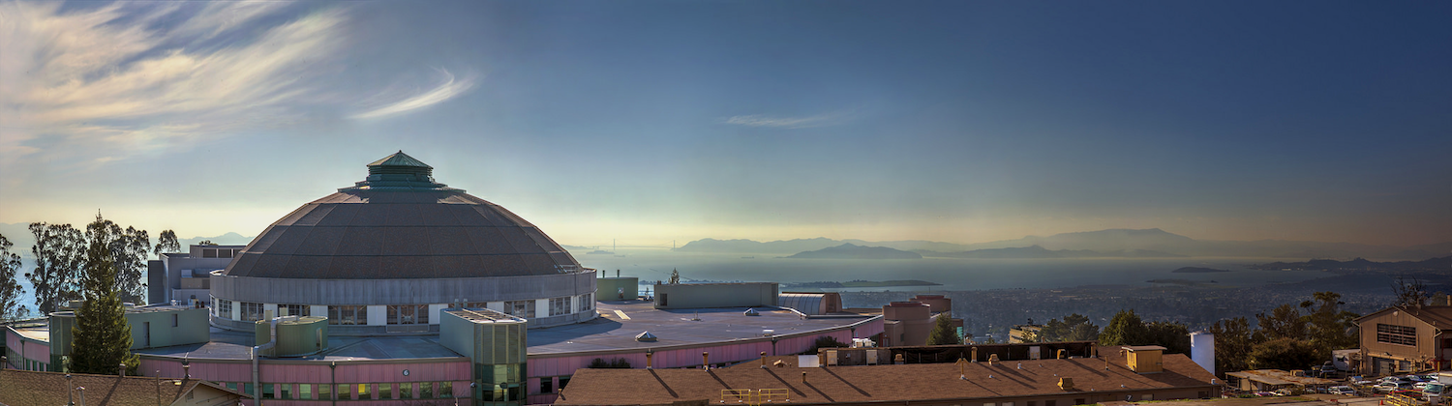



SPOT etc. at the ALS
February 2017

Slide 2

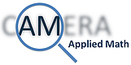



SUPER-
FACILITY

Slide 3
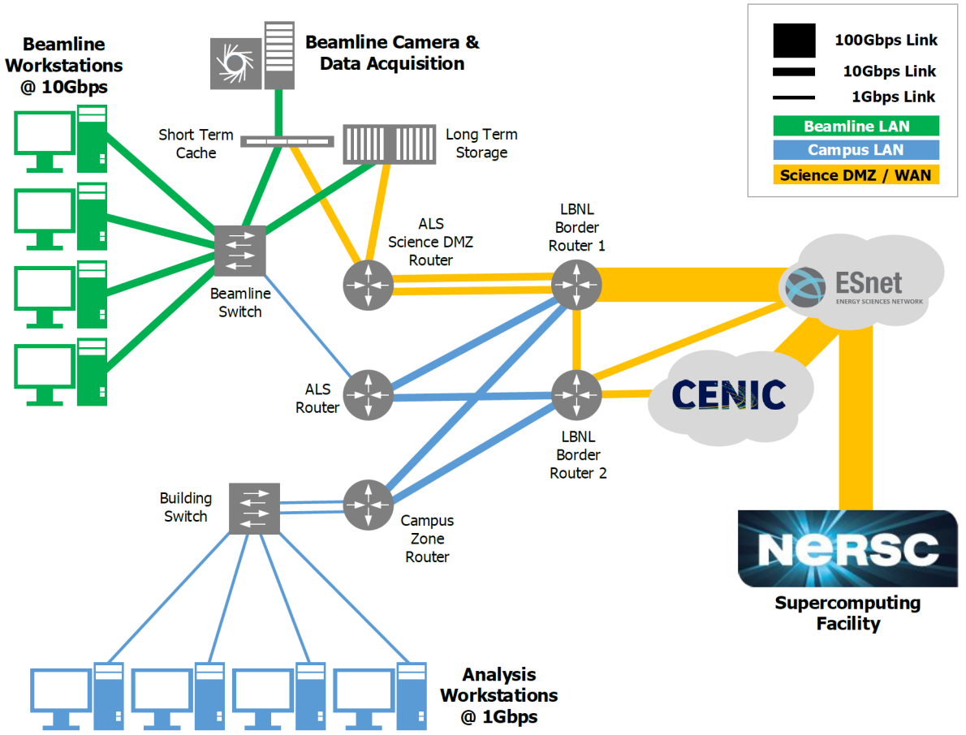

Slide 4
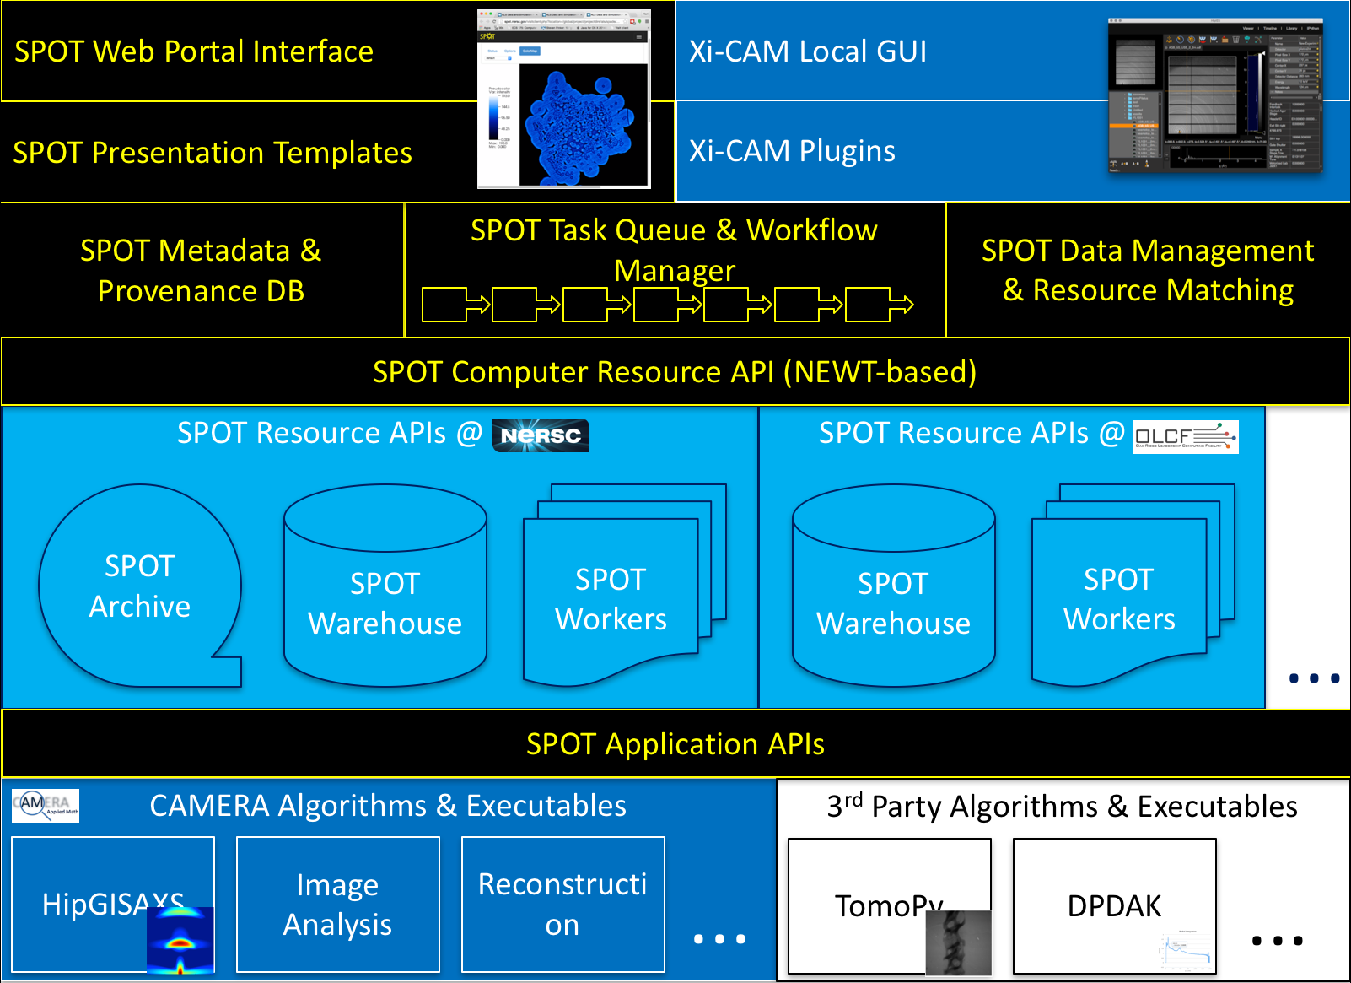
Presentation Layers
SPOT Services
Compute Resources
Applications

Slide 5
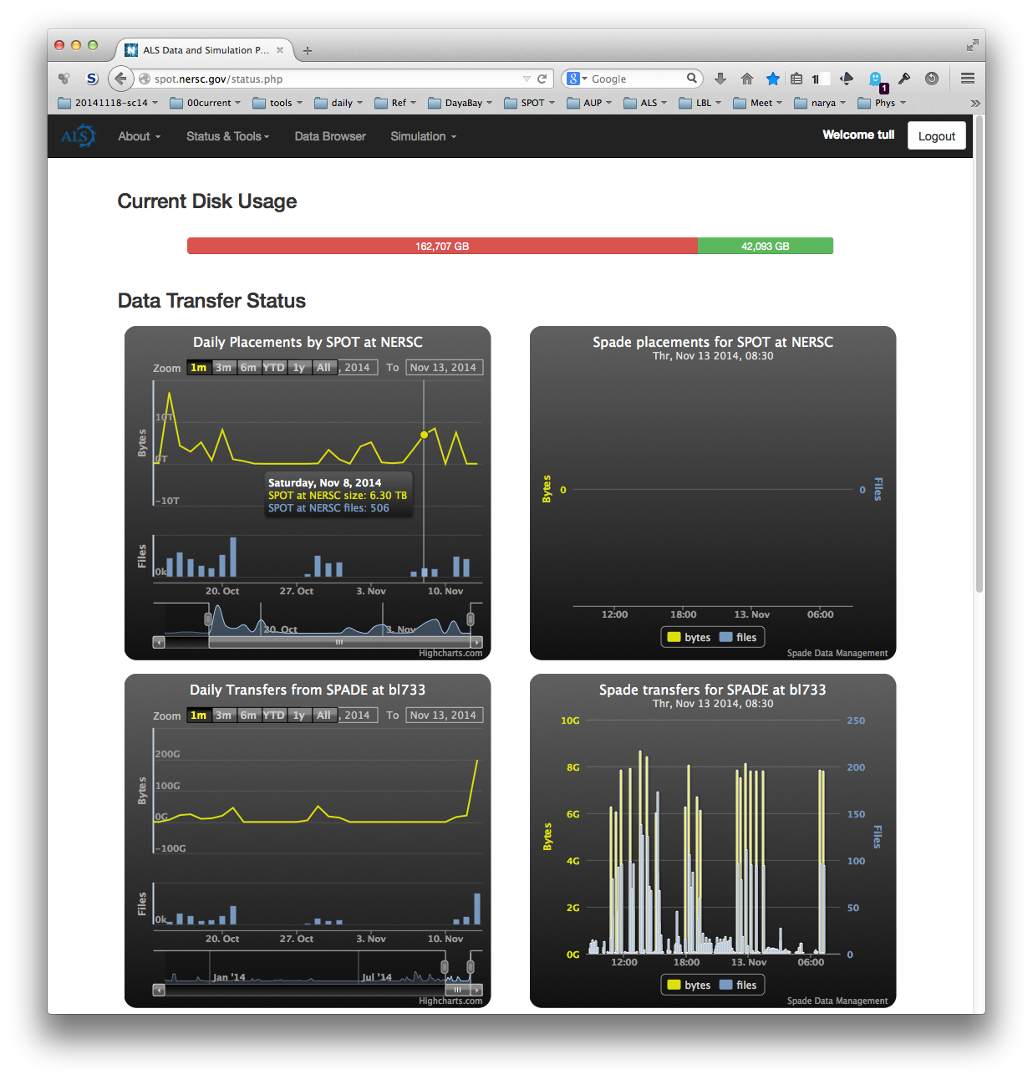
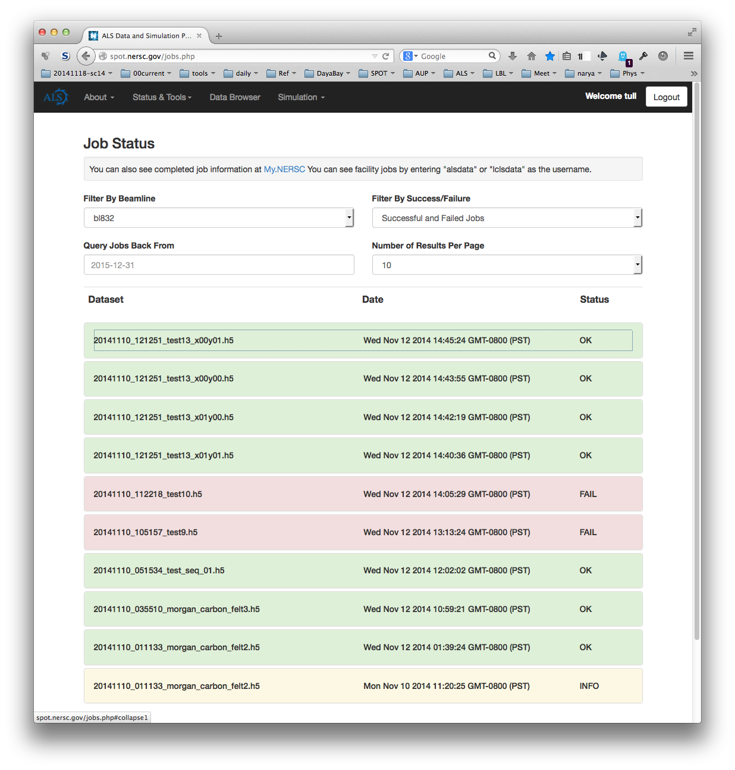
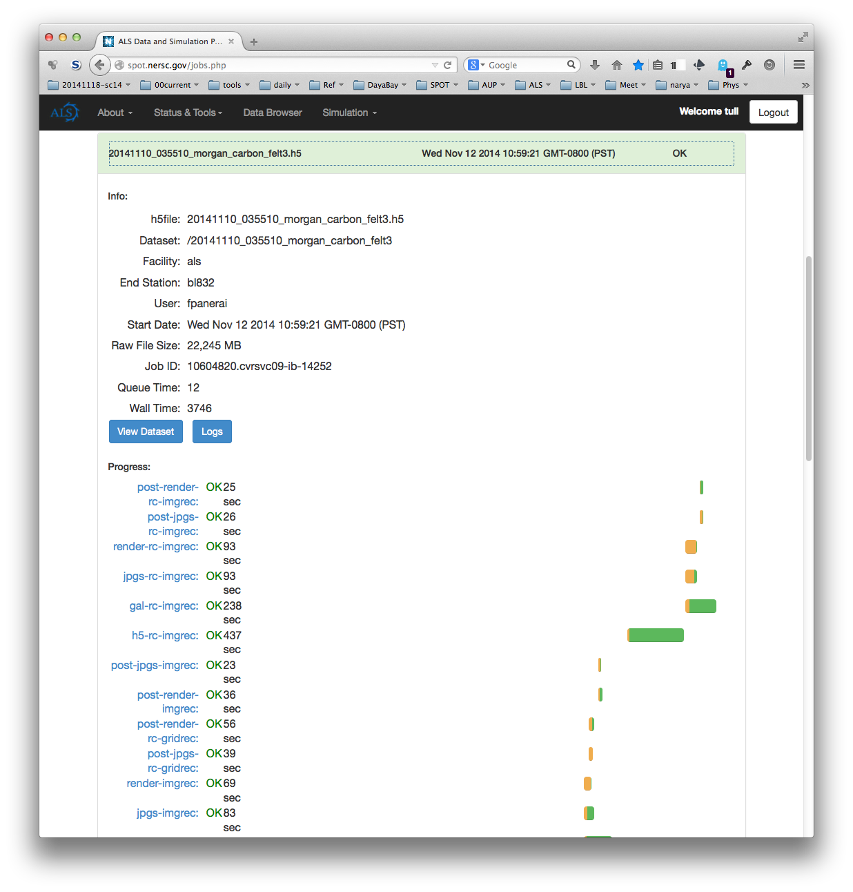
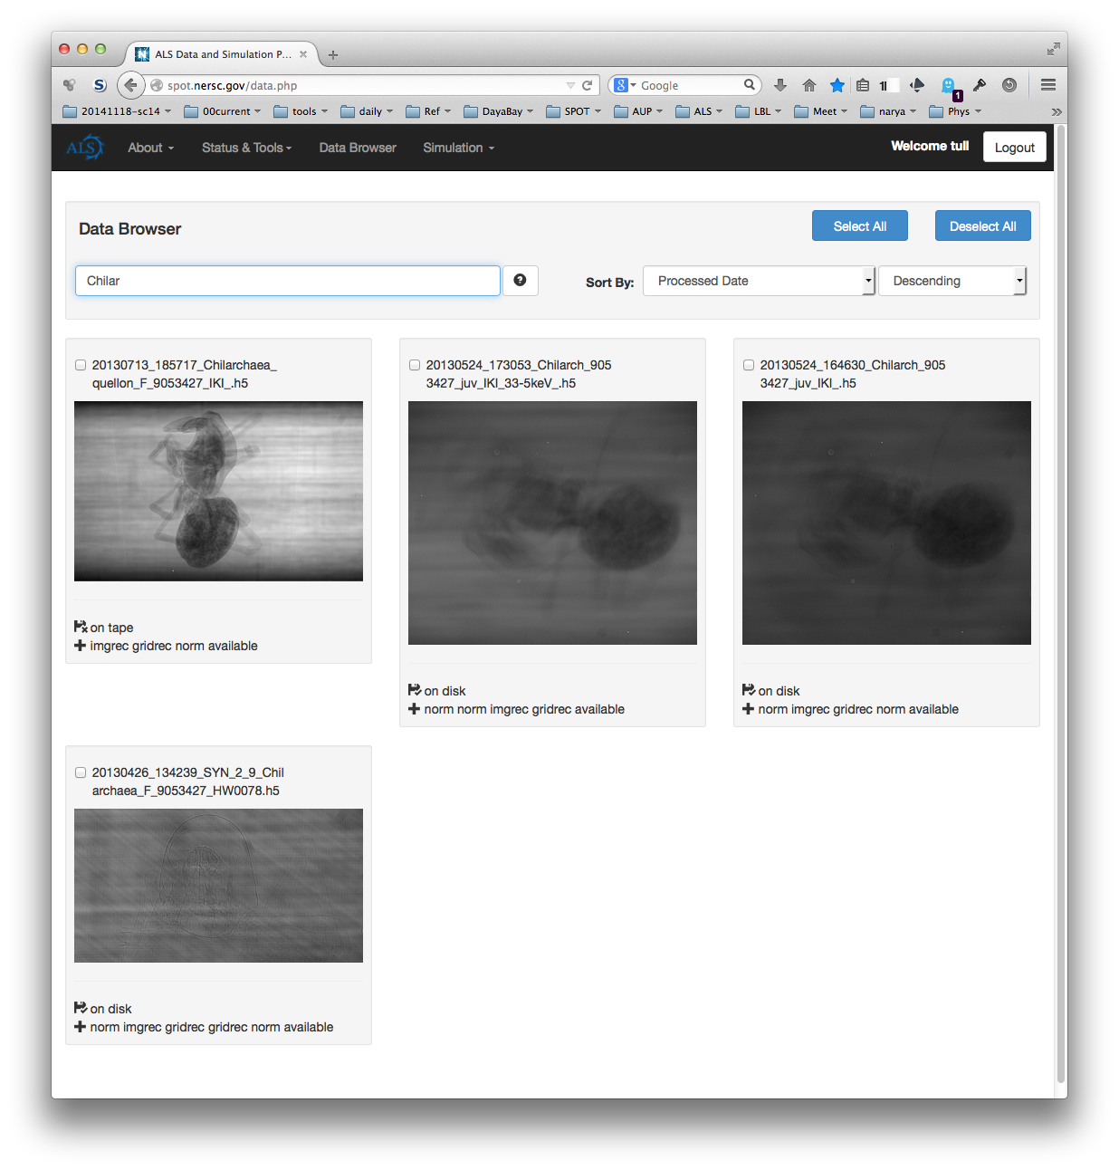
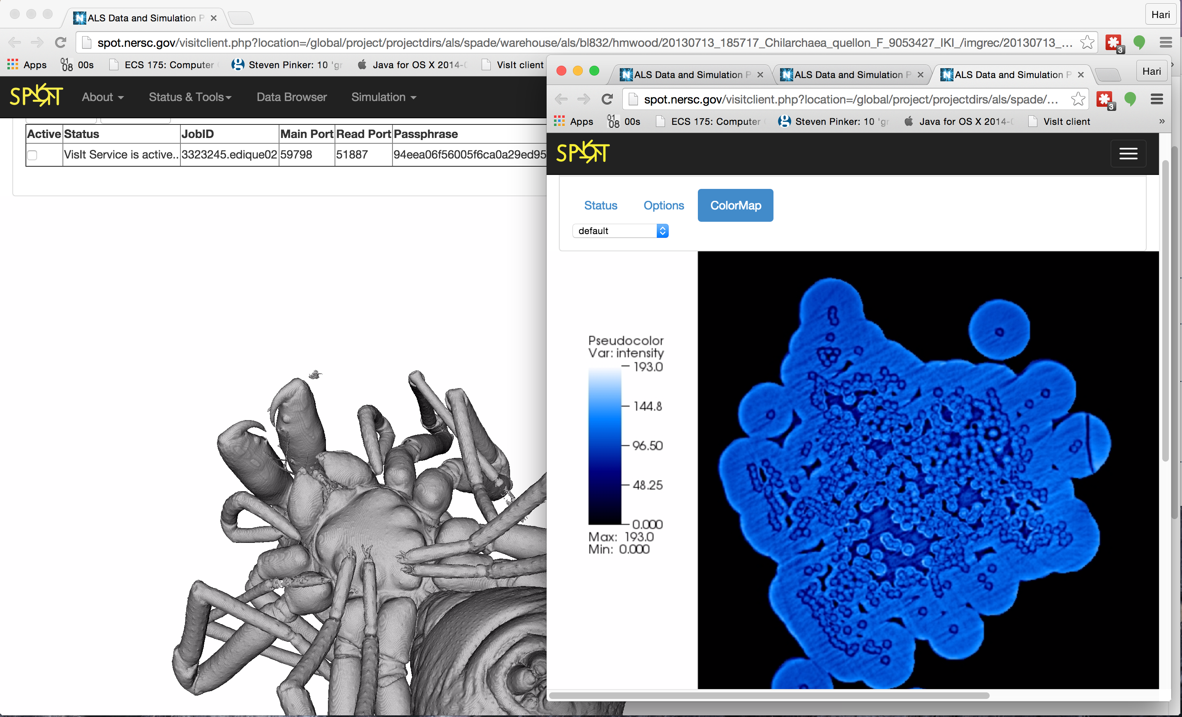
SPOT Suite

Slide 6
SPOT Suite Details
Prior experience and tools:
Spade (IceCube, Daya Bay)
Science Data Gateways (NERSC)
Domain Applications (ALS)
Multiple ALS Beamlines:
8.3.2 – Micro-Tomography (D.Parkenson)
7.3.3 – SAXS/WAXS (A.Hexemer)
12.3.4 – Micro-Diffraction (N.Tamura)
Multiple Facilities (demos):
APS – Advanced Photon Source (BNL)
LCLS – Linac Coherent Light Source
NSLS - National Synchrontron Light Source
CS Research Partnerships:
CAMERA – Advanced Math & Algorithms
X-SWAP – Workflow Modeling & Optimization
DEDUCE – Data Analystics Infrastructure
Pseudo-production running at ALS beamlines (Feb 2017)
24/7 Operation
330,000 Datasets
~200 Beamline Users
>2.7 PB Data Stored
>4.5 million Jobs at NERSC
Portal interfaces for:
Data monitoring & control
Job monitoring
Job inspection
Data browsing and searching
Browser-based remote viz
… metadata, provenance, algorithms, theory-simulation, etc.

Slide 7
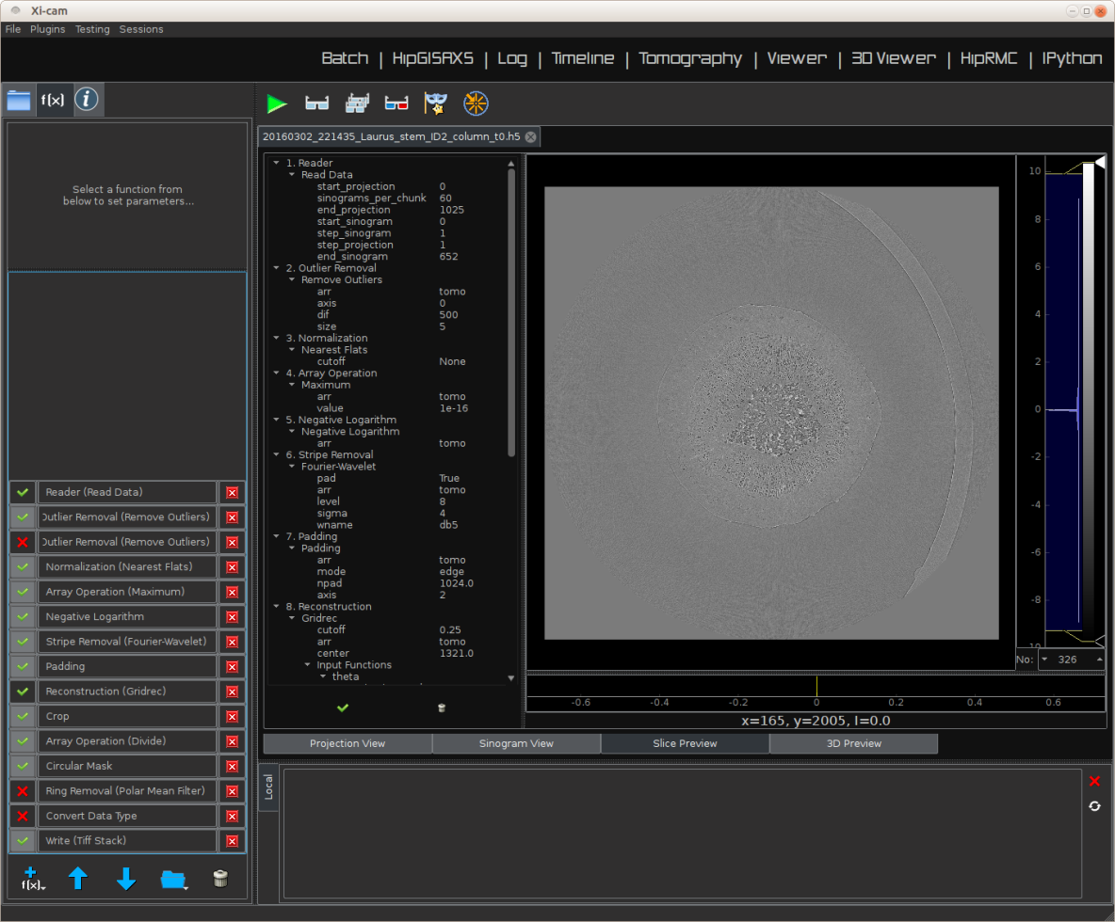
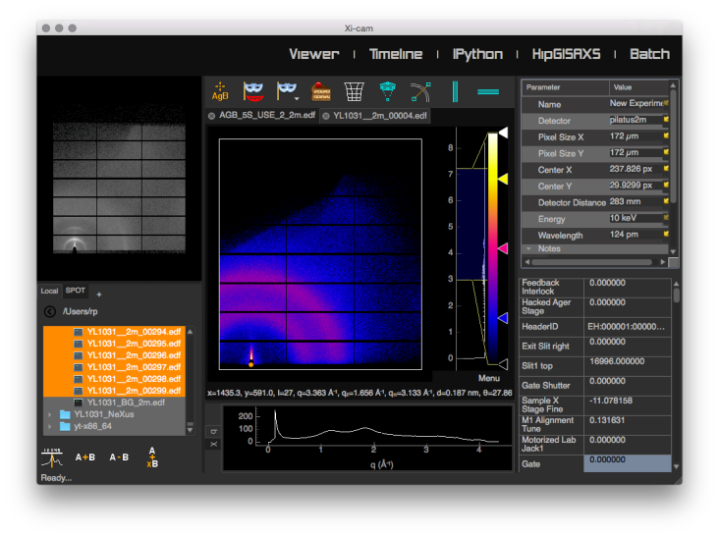
Xi-CAM Analysis Interface
Plugin architecture
Scattering
Tomography
Easy to add more
Data and computation can be local or remote

Slide 8
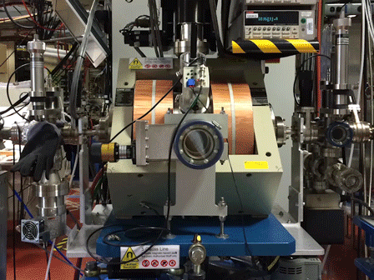
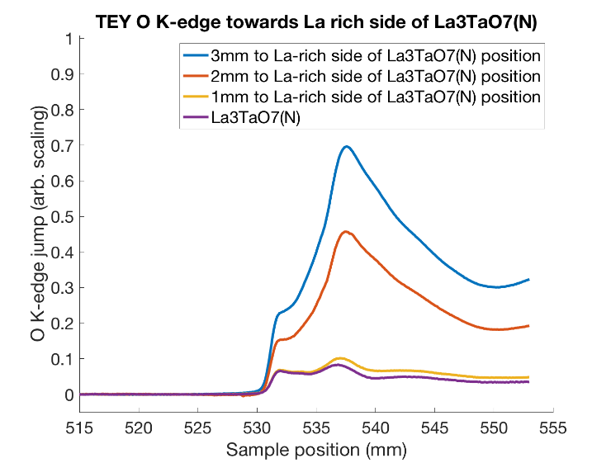
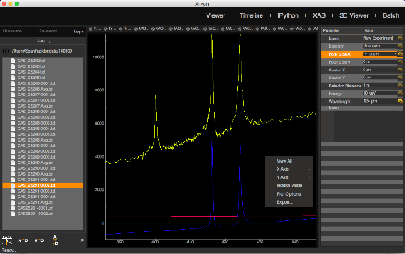
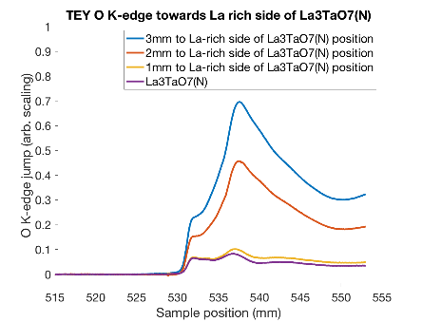
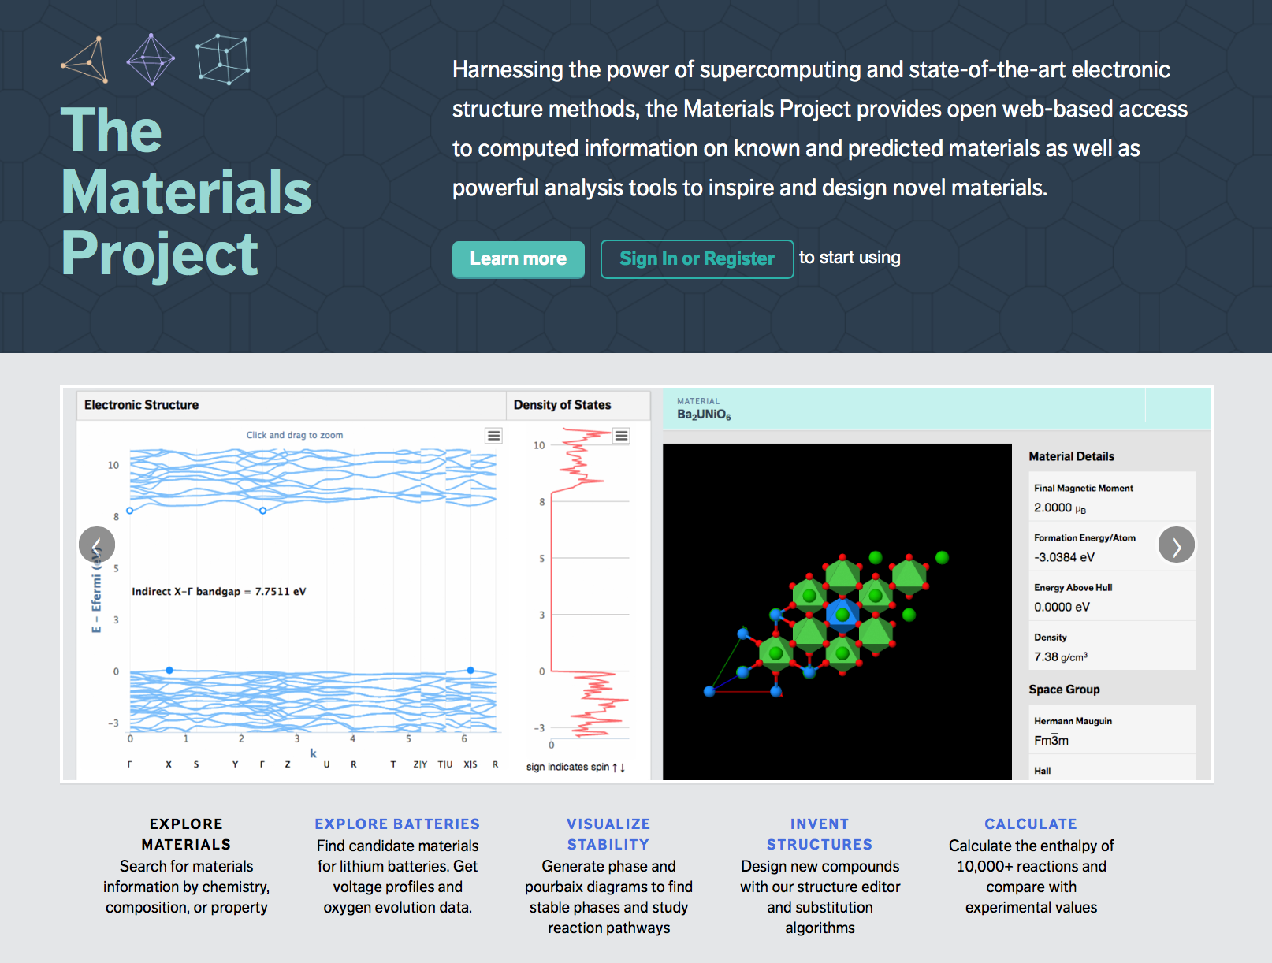
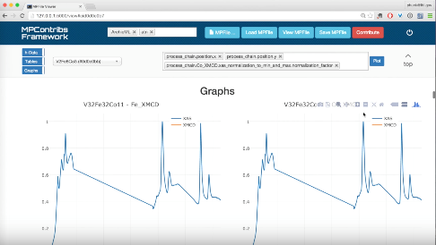
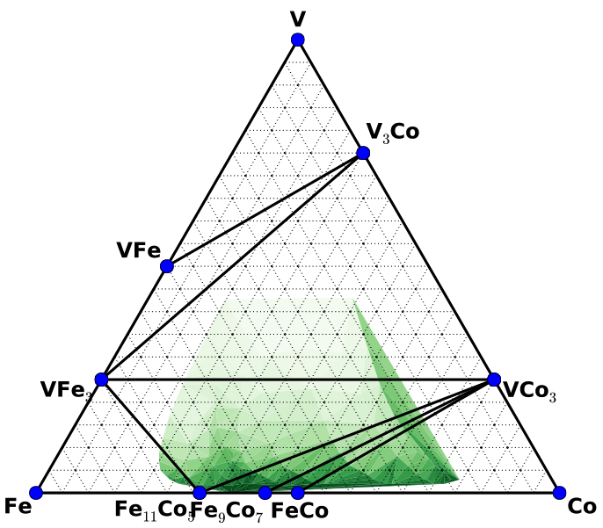

NEXAFS Analysis and link to the Materials Project
BL 6.3.1
Xi-CAM
Processing/reduction
Materials Project
website
Quantities
Community
Analysis
Phase
diagrams
Results

